Slide 1
Distributed Systems 15-440/15-640 – Fall 2018
12 – Distributed Replication Thursday, Oct 4th, 2018

Slide 2
Organizational Updates
P1
part A Due 10/6 -- Good Luck! You can do it!
Part B Released – Due 10/16 (Recitation was yesteday)
Mid Term 10/18 – 10:30am – Noon
The class after us has a mid term, so we will try to finish ~5min early

Slide 3
Fault Tolerance Techniques So Far?
Redundancy: information / time / physical redundancy
E.g., used in airplanes
Recovery: checkpointing and logging (ARIES)
E.g., used in commercial databases
Previous (concurrency) protocols rely on recovery techniques
E.g., Two Phase Commit is not fault tolerant by itself
Why not always use these techniques?
→ Long wait in case of failure

Slide 4
Our Goal Today: Stay Up During Failures
Provide a service
Replicate the machines that serve clients
Survive the failure of up to f replicas
Provide identical service to a non-replicated version
(except more reliable, and perhaps different performance)

Slide 5
Outline for Today
Consistency when content is replicated
Primary-backup replication model
Consensus replication model

Slide 6
Simple Examples of Replication
Replicated web sites
e.g., Yahoo! or Amazon:
DNS-based load balancing (DNS returns multiple IP addresses for each name)
Hardware load balancers put multiple machines behind each IP address
When is replication easy? When hard?
Workload assumptions

Slide 7
Read-only content
Easy to replicate - just make multiple copies of it.
Performance boost: Get to use multiple servers to handle the load;
Perf boost 2: Locality. We’ll see this later when we discuss CDNs, can often direct client to a replica near it
Availability boost: Can fail-over (done at both DNS level -- slower, because clients cache DNS answers -- and at front-end hardware level)

Slide 8
But Read-write Data...
Requires write replication, and some degree of consistency
Strict Consistency
Read always returns value from latest write
Sequential Consistency
All nodes see operations in some sequential order
Operations of each process appear in-order in this sequence

Slide 9
Sequential Consistency (1)
Behavior of two processes operating on the same data item. The horizontal axis is time.
P1: Writes “W” value a to variable “x”
P2: Reads `NIL’ from “x” first and then `a’
Adapted from: Tanenbaum & Van Steen, Distributed Systems: Principles and Paradigms, 2e, (c) 2007 Prentice-Hall, Inc. All rights reserved. 0-13-239227-5
Notes:
Pg/282/Tanenbaum
Idea is that P1 writes to variable X, updating it to Value a. That update is propagated to all other local copies.
At some point P2 reads x, gets a value Nil (since it was unitalized) and then subsequently gets a value of “a” for variable x.

Slide 10
Sequential Consistency (2)
(b) A data store that is not sequentially consistent.
(a) A sequentially consistent data store.
Notes:
(a) Is sequentiually consistent since even though P3 and P4 first read the value of ‘x’ as a and then b, both of them have the same view.
(b) Is not sequentially consistent since at the end, P3 and P4 will have different values of x ( a or b) at the end.

Slide 11
But Read-write Data...
Requires write replication, and some degree of consistency
Strict Consistency
Read always returns value from latest write
Sequential Consistency
All nodes see operations in some sequential order
Operations of each process appear in-order in this sequence
Causal Consistency
All nodes see potentially causally related writes in same order
But concurrent writes may be seen in different order on different machines

Slide 12
Causal Consistency (1)
This sequence is allowed with a causally-consistent store, but not with a sequentially consistent store.
Notes:
Note: P1: W(x)c and P2: W(x)b are concurrent so its not important that all processes see them in the same order
However Wx(a) and R(x) a and then W(x)b are potentially causally related so they must be in order.

Slide 13
Causal Consistency (2)
A violation of a causally-consistent store.
(W(x)a causally related to R(x)a, W(x)b.)
Notes:
P2 W(x) b may be causally realted to the W (x) a -- for example it may be the result of value read in P2: R (x) a and hence the two writes are causally related.
If so, then P3 and P4 must see them in the same order and the currnet output is incorrect and violates causally consistent ordering.

Slide 14
But Read-write Data...
Requires write replication, and some degree of consistency
Strict Consistency
Read always returns value from latest write
Sequential Consistency
All nodes see operations in some sequential order
Operations of each process appear in-order in this sequence
Causal Consistency
All nodes see causally related writes in same order
But concurrent writes may be seen in different order on different machines
Eventual Consistency
All nodes will learn eventually about all writes, in the absence of updates

Slide 15
Example of Consistency Guarantees
In practice we often have a choice
Google Mail
Sending mail is replicated to ~2 physically separated datacenters (users hate it when they think they sent mail and it got lost); mail will pause while doing this replication.
Q: How long would this take with 2-phase commit? in the wide area?
Marking mail read is only replicated in the background - you can mark it read, the replication can fail, and you’ll have no clue (re-reading a read email once in a while is no big deal)
Weaker consistency is cheaper if you can get away with it.

Slide 16
Replication Strategies
What to replicate: State versus Operations
Propagate only a notification of an update
Sort of an “invalidation” protocol
Transfer data from one copy to another
Read-to-Write ratio high, can propagate logs (save bandwidth)
Propagate the update operation to other copies
Don’t transfer data modifications, only operations – “Active replication”
When to replicate: Push vs Pull
Pull Based
Replicas/Clients poll for updates (caches)
Push Based
Server pushes updates (stateful)
Notes:
Invalidation part just tells the replicas that their copy of the data is invalid and maybe even which part is invalid.
Key thing is no more than an invalidation message is sent.
Advantage: Low network bandwith
Transfer copy from one to the other:
read-to-write ratio high, transfer data to replica. Can also
Propagate update operations -= assumes that each replica has a process capable of actively keeping its data in sync by update operations

Slide 17
Outline for Today
Consistency when content is replicated
Primary-backup replication model
Consensus replication model

Slide 18
Assumptions Today
Group membership manager
Allow replica nodes to join/leave
Fail-stop (not Byzantine) failure model
Servers might crash, might come up again
Delayed/lost messages
Failure detector
E.g., process-pair monitoring, etc.

Slide 19
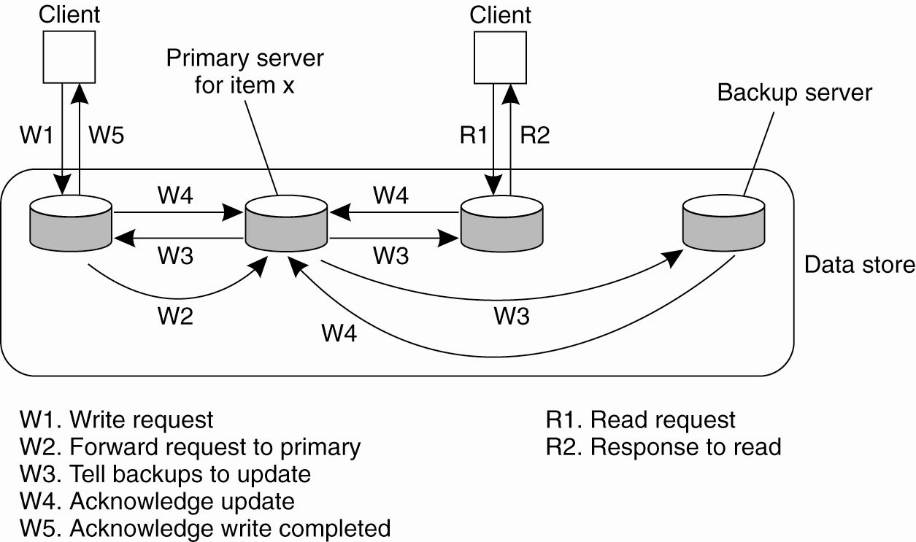
Primary-Backup: Remote Write Protocol
Writes always go to primary, read from any backup
Implementation
Stream the log
Common in practice
Simple
Are updates blocking?
Notes:
The simplest form of primary backup protocol that supports replication is where all the writes go to a single server (fixed) and the read operations can be carried out locally.
Due to blocking operation, processes will see the effects of the most recent write.
Non blocking means that the Primary issues an ACK after it receives and commits a local copy of item “x” and then tells the backups/replica to update it. This comes at the cost of fault tolerance.

Slide 20
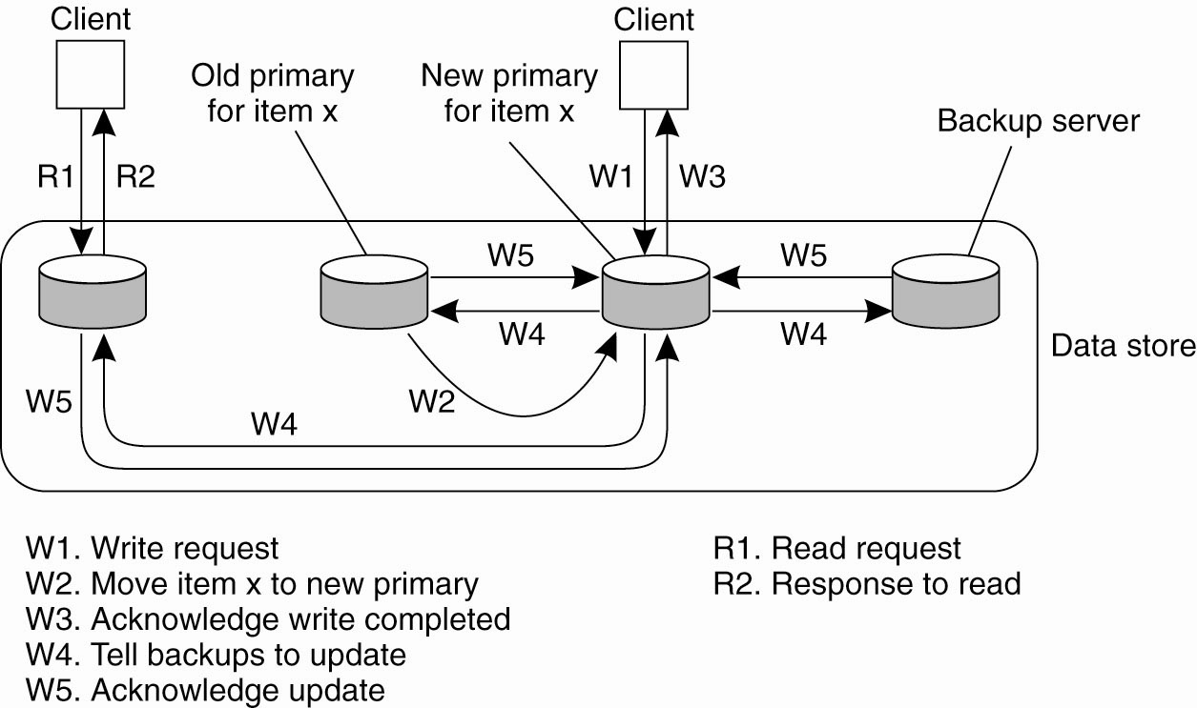
Local-Write P-B Protocol
Primary migrates to the process wanting to process update For performance, use non-blocking op.
What does this scheme remind you of?
Notes:
Variant of PB, where the primary migrates copy of a particular item migrates to the process that wants to perform update.
Advatage: multiple successive write opeations can be peformed locally on the replicas, while reading processes can access their local copy.
Note, for the actual performance advantage, you must apply non-blocking protocol.
This is a useful scheme for Mobile computers. Before disconnecting, a mobile client can become the primary server for the files it wants to update. All update operations (in disconnected mode) are done locally and then propagated from the primary to the backups to bring things into a consistent state again. (somewhat like CODA?)

Slide 21
Primary-Backup Properties
This looks cool. How many failures can we deal with? What are some problems?
What do we do if a replica has failed?
We wait... how long? Until it’s marked dead.
Advantage: With N servers, can tolerate loss of N-1 copies
Not a great solution if you want very tight response time even when something has failed: Must wait for failure detector
Note: If you don’t care about strong consistency (e.g., the “mail read” flag), you can reply to client before reaching agreement with backups (sometimes called “asynchronous replication”).

Slide 22
Implementing P-B
Remember logging? :-)
Common technique for replication in databases and filesystem-like things: Stream the log to the backup. They don’t have to actually apply the changes before replying, just make the log durable.
You have to replay the log before you can be online again, but it’s pretty cheap.

Slide 23
p-b: Did it happen?
Client
Primary
Backup
Commit!
Log
Commit!
OK!
OK!
Log
OK!
Failure here:
Commit logged only at primary
Primary dies? Client must re-send to backup

Slide 24
p-b: Happened twice
Client
Primary
Backup
Commit!
Commit!
Log
OK!
Log
OK!
Failure here:
Commit logged at backup
Primary dies? Client must check with backup
(Seems like at-most-once / at-least-once... :)

Slide 25
Outline for Today
Consistency when content is replicated
Primary-backup replication model
Consensus replication model

Slide 26
Quorum Based Consensus
Designed to have fast response time even under failures
Operate as long as majority of machines is still alive
No master, per se
To handle f failures, must have 2f + 1 replicas
Also, for replicated-write => write to all replica’s not just one
Usually boils down to Paxos [Lamport]
Notes:
Major difference, you want replicated Write protocols so that you can write to multiple replicas instead of just one.

Slide 27
The Paxos Approach
Decompose the problem:
Basic Paxos (“single decree”):
One or more servers propose values
System must agree on a single value as chosen
Only one value is ever chosen
Multi-Paxos:
Combine several instances of Basic Paxos to agree on a series of values forming the log
Some Slides Adapted from: John Ousterhout & Diego Ongaro, Stanford University. Implementing Replicated Logs with Paxos. 2013.
Notes:
Adapted from: John Ousterhout & Diego Ongaro, Stanford University. Implementing Replicated Logs with Paxos. 2013.
https://ramcloud.stanford.edu/~ongaro/userstudy/paxos.pptx

Slide 28
Requirements for Basic Paxos
Correctness (safety):
Only a single value may be chosen
A machine never learns that a value has been chosen unless it really has been
The agreed value X has been proposed by some node
Liveness (termination) :
Some proposed value is eventually chosen
If a value is chosen, servers eventually learn about it
Fault-tolerance:
If less than N/2 nodes fail, the rest should reach agreement eventually w.h.p
Liveness is not guaranteed
Notes:
PAXOS sacrifices liveness in favor of correctness

Slide 29
[FLP’85] Impossibility Result
Synchronous DS: bounded amount of time node can take to process and respond to a request
Asynchronous DS: timeout is not perfect
Fischer-Lynch-Paterson Result
It is impossible for a set of processors in an asynchronous system to agree on a binary value, even if only a single processor is subject to an unannounced failure.
Notes:
Fail-stop vs Fail-recover faults. Synchronous systems vs asynchronous systems.
Optional Additional Reading: http://the-paper-trail.org/blog/consensus-protocols-paxos/
https://www.the-paper-trail.org/post/2008-08-13-a-brief-tour-of-flp-impossibility/
Wikipedia: https://en.wikipedia.org/wiki/Consensus_(computer_science)
“The FLP result does not state that consensus can never be reached: merely that under the model's assumptions, no algorithm can always reach consensus in bounded time. In practice it is highly unlikely to occur.”

Slide 30
Paxos Components
Proposers:
Active: put forth particular values to be chosen
Handle client requests
Acceptors:
Passive: respond to messages from proposers
Responses represent votes that form consensus
Store chosen value, state of the decision process
For this presentation:
Each Paxos server contains both components
Ignore third role, aka Learner
“Round”: (proposal, messages/voting, decision)
We may need several rounds
Proposer Acceptor
Proposer Acceptor
Proposer Acceptor

Slide 31
Strawman: Basic Two-Phase
Coordinator tells replicas: “Value V”
Replicas ACK
Coordinator broadcasts “Commit!”
This isn’t enough
What if there’s more than 1 coordinator at the same time?
What if new coordinator chooses a different value?
What if some of the nodes or the coordinator fails during the communication?
What if there is a network partition?

Slide 32
Let’s Discuss Some Problems & Solutions
Problem: can’t trust a single node
Solution: everyone can potentially propose
Problem: several concurrent proposers
Solution: Quorum (require majority of acceptors)
Problem: split votes, no proposer reaches majority
Solution: acceptors need to allow updating of their value
Problem: conflicting choices (due to updating)
Solution a): prioritize proposal with highest unique time stamp (Lamport clocks)
Solution b): once majority has agreed on value, future proposals forced to propose/choose same value

Slide 33
Single Decree Paxos: Informal Description
Phase 1: Prepare message
Find out about any chosen values
Block older proposals that have not yet completed
Phase 2: Accept message
Ask acceptors to accept a specific value
(Phase 3): Proposer decides
If majority again: chosen value, commit.
If no majority: delay and restart Paxos
Proposers
Acceptors
Prepare
Check,
Return
Wait for
majority
Accept
Check Again,
Return
Wait for
majority
Decision

Slide 34
Single Decree Paxos: Protocol
Proposers
Choose new proposal number n, value v
Broadcast Prepare(n) to all servers
When responses received from majority:
If any acceptedValues returned
v = acceptedValue of highest acceptedProposal
Broadcast Accept(n, value) to all servers
When Accept-OK from majority
Value is chosen (Commit)
Else
Restart: goto 1, with larger number n
Acceptors
Respond to Prepare(n):
If n > minProposal then minProposal = n
Prepare-OK(acceptedProposal, acceptedValue)
else
Prepare-REJECT()
Respond to Accept(n, value):
If n ≥ minProposal acceptedProposal = minProposal = n acceptedValue = value
Accept-OK()
else
Accept-REJECT()
Acceptors must record minProposal, acceptedProposal, and acceptedValue on stable storage (disk)

Slide 35
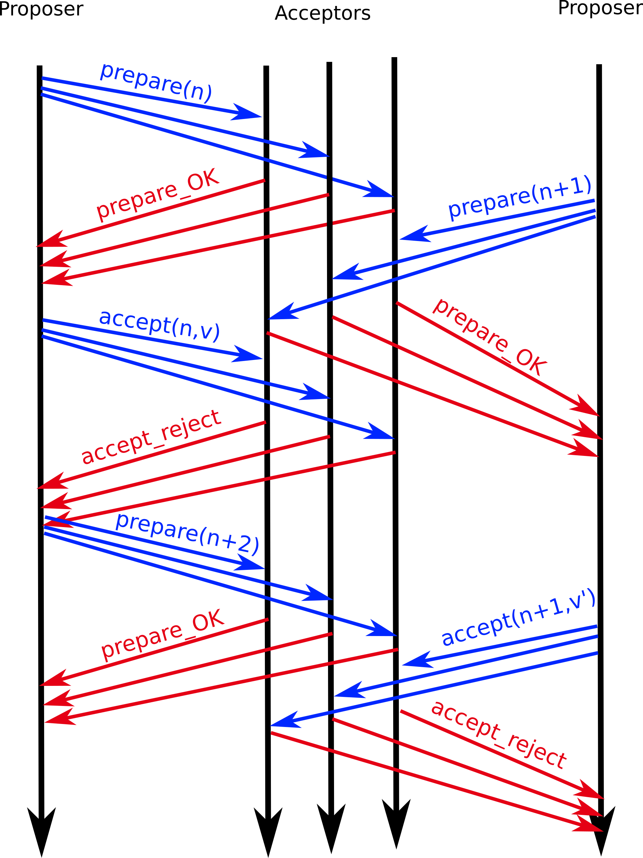
Paxos Examples
Successful
Round with a
Single Proposer
b) Dueling
Proposers
Notes:
Coordinators are essentially Leaders in Paxos

Slide 36
Some Remarks
Only proposer knows chosen value (majority accepted)
Only a single value is chosen → MultiPaxos
No guarantee that proposer’s original value v is chosen by itself
Number n is basically a Lamport clock → always unique n
Key invariant:
If a proposal with value `v' is chosen, all higher proposals must have value `v’
Dueling proposer
Resolved using number n in prepare
There are challenging corner cases
Notes:
Coordinators are essentially Leaders in Paxos

Slide 37
Single Decree Paxos: Protocol
Proposers
Choose new proposal number n, value v
Broadcast Prepare(n) to all servers
When responses received from majority:
If any acceptedValues returned
v = acceptedValue of highest acceptedProposal
Broadcast Accept(n, value) to all servers
When Accept-OK from majority
Value is chosen (Commit)
Else
Restart (goto 1, with larger number n)
Acceptors
Respond to Prepare(n):
If n > minProposal then minProposal = n
Prepare-OK(acceptedProposal, acceptedValue)
else
Prepare-REJECT()
Respond to Accept(n, value):
If n ≥ minProposal acceptedProposal = minProposal = n acceptedValue = value
Accept-OK()
else
Accept-REJECT()
Acceptors must record minProposal, acceptedProposal, and acceptedValue on stable storage (disk)

Slide 38
Paxos is widespread!
Industry and academia
Google: Chubby (distributed lock service)
Yahoo: Zookeeper (distributed lock service)
MSR: Frangipani (distributed lock service)
OpenSource implementations
Libpaxos (paxos based atomic broadcast)
Zookeeper is open source, integrated w/Hadoop
Paxos slides adapted from Jinyang Li, NYU;

Slide 39
Paxos History
It took 25 years to come up with safe protocol
2PC appeared in 1979 (Gray)
In 1981, a basic, unsafe 3PC was proposed (Stonebraker)
In 1998, the safe, mostly live Paxos appeared (Lamport)
2001 ”Paxos made simple”.
In ~2007 RAFT appears

Slide 40
Multi-Paxos
Separate instance of Basic Paxos for each new decision
Add index argument to Prepare and Accept (selects entry in log)
E.g., distributed log
Performance optimizations:
Use leader to reduce proposer conflicts
Eliminate most Prepare requests
jmp
Known Chosen
1
2
3
4
5
6
7
1
2
3
4
5
6
7
s₁
mov
add
cmp
ret
s₁
mov
add
cmp
sub
jmp
ret
s₂
mov
add
sub
ret
s₂
mov
add
cmp
sub
jmp
ret
s₃
mov
add
cmp
cmp
ret
s₃
mov
add
cmp
shl
ret
Logs Before
Logs After

Slide 41
More Remarks
Paxos is painful to get right, particularly the corner cases. Start from a good implementation if you can. See Yahoo’s “Zookeeper” as a starting point.
There are lots of optimizations to make the common / no or few failures cases go faster; if you find yourself implementing, research these.
Paxos is expensive. Usually, used for critical, smaller bits of data and to coordinate cheaper replication techniques such as primary-backup for big bulk data.
Notes:
Multi-Paxos not clearly defined in literature. Slight variations in practice.
Some Paxos use cases (given that it is expensive):
e.g. Nodes agree that X is the primary e.g. Nodes agree that W should be the most recent operation executed

Slide 42
Beyond PAXOS
Many follow ups and variants
RAFT consensus algorithm
https://raft.github.io/
Great visualization of how it work
http://thesecretlivesofdata.com/raft/

Slide 43
Summary
Primary-backup
Writes handled by primary, stream log to backup(s)
Replicas are “passive”, follow primary
Good: Simple protocol. N machines, can handle N-1 failures
Bad: Slow response times in case of failures.
Quorum consensus
Designed to have fast response time even under failures
Replicas are “active” - participate in protocol; there is no master, per se.
Good: Clients don’t even see the failures
Bad: More complex (corner cases). To handle f failures, must have 2f + 1 replicas.

